Slide 1
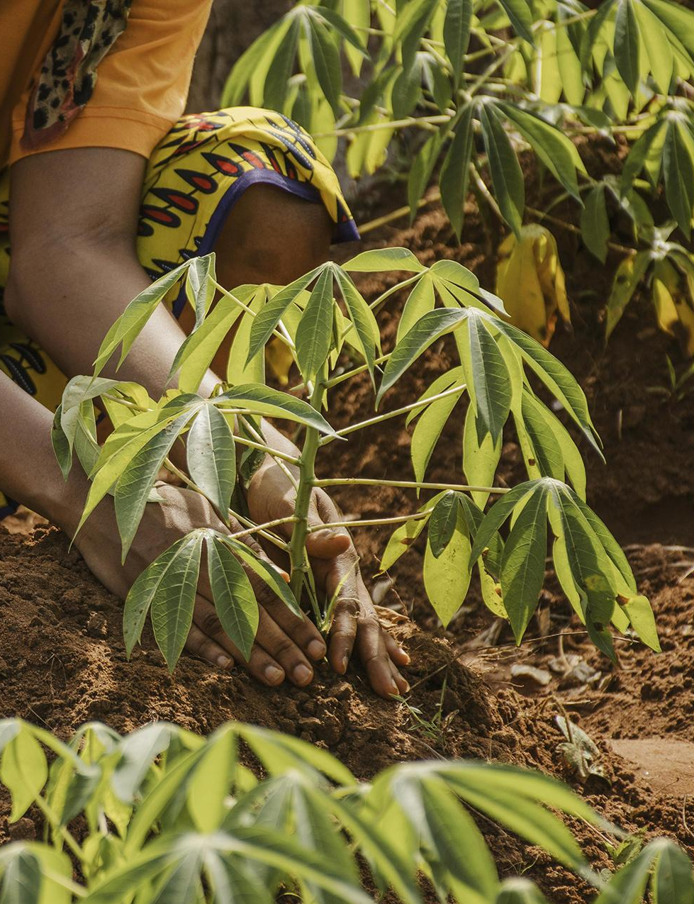
Sustainable Agriculture

Slide 2
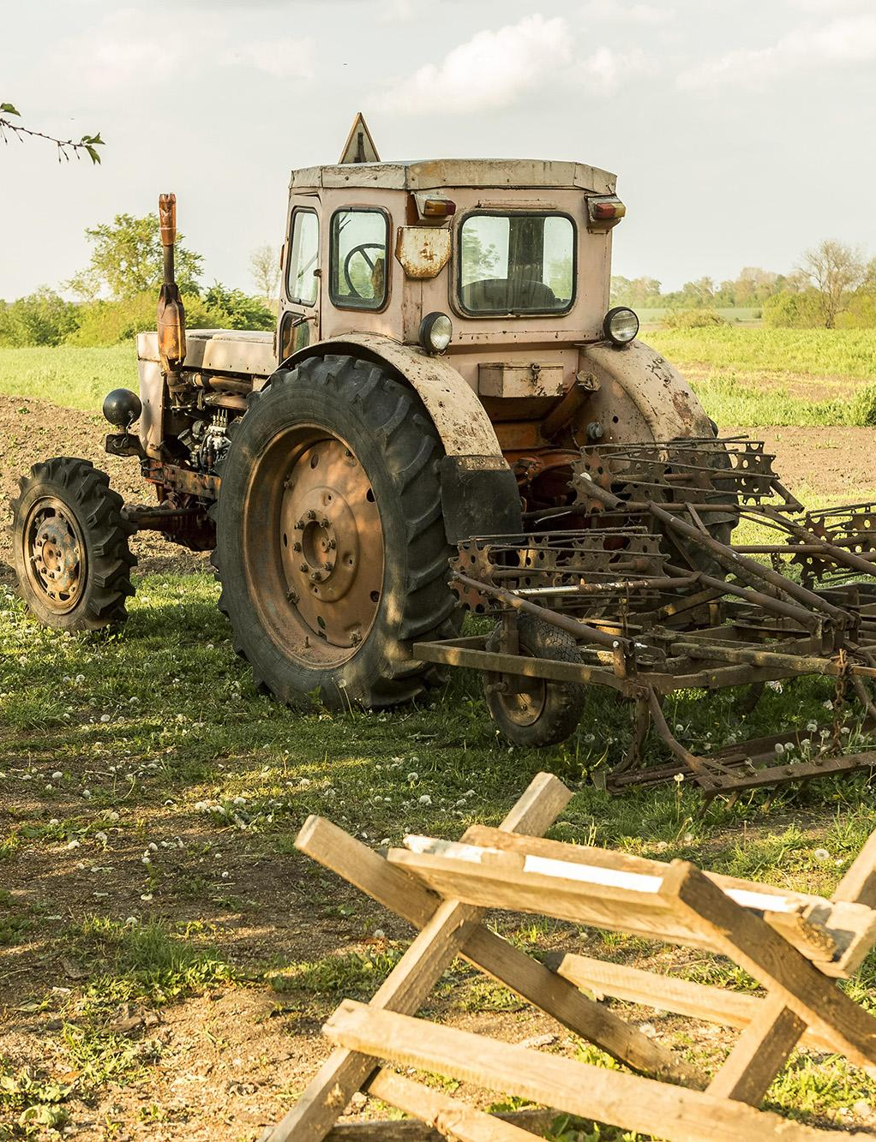
Let’s hear what superman and Batman saying about Sustainable Agriculture….

Slide 3


It’s about farming methods that minimize emissions and environmental impact while still producing food.
What is sustainable agriculture all about?

Slide 4
Yes! Sustainable practices can lead to healthier food and ecosystems, benefiting both farmers and consumers.
So, how do farmers do that?

Slide 5
Yes! Sustainable practices can lead to healthier food and ecosystems, benefiting both farmers and consumers.
That sounds important! Does it also help with food quality?

Slide 6
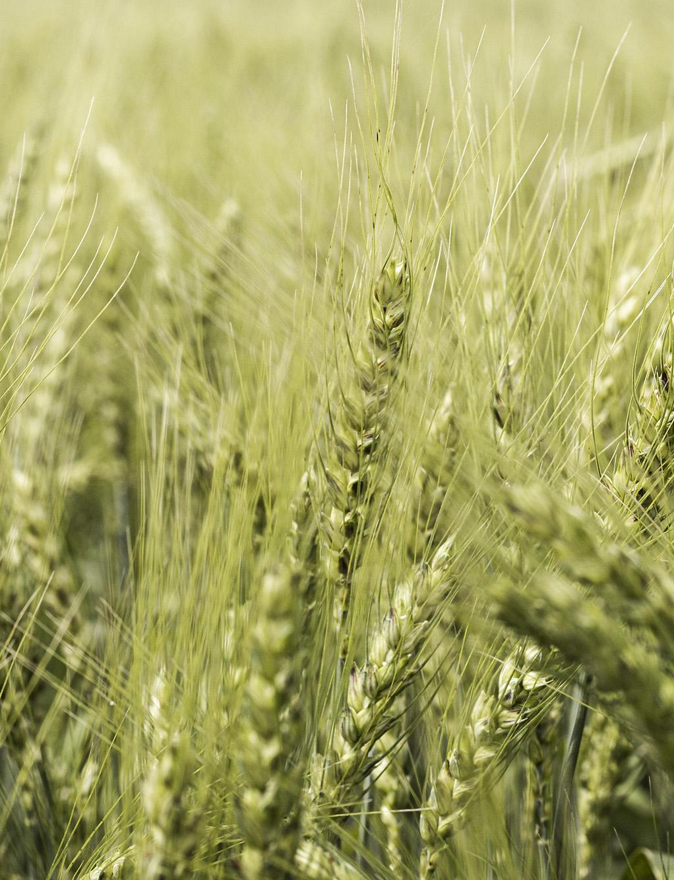
I love that! Eating sustainably is good for the planet and our health!

Slide 7
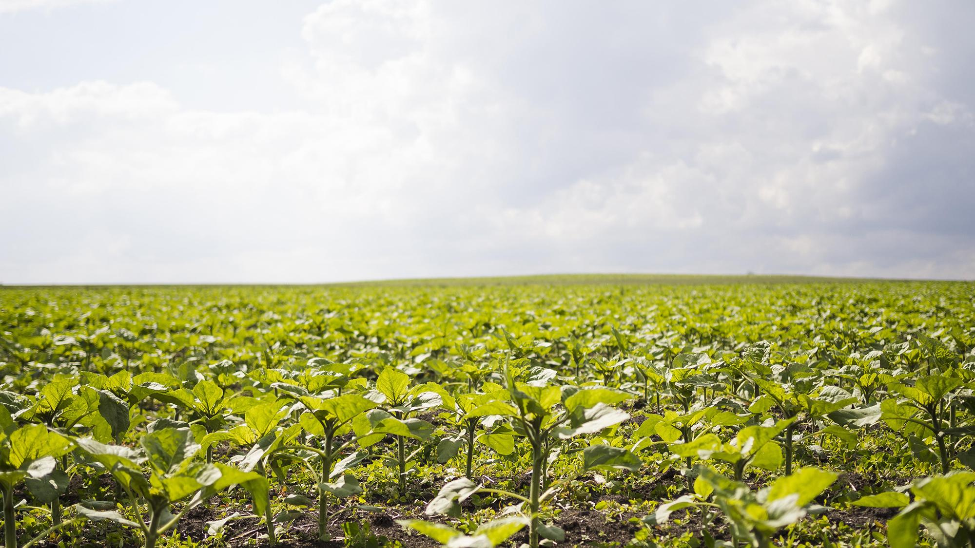
In our journey toward sustainable agriculture, we cultivate not just crops, but a future that respects our planet's resources. By minimizing emissions from food production, we ensure that nourishment does not come at the cost of our environment. Together, we can redefine how we grow and consume food for a healthier world…

